Slide 1
DNS
IP address
HTTP traffic to IP Address (GET or POST etc)
Apache sniffing 80 or 443
Deals with request

Slide 2
XampP
Install XAMPP
Install VSCode
http://localhost
http://127.0.0.1
(there’s no place like home)

Slide 3

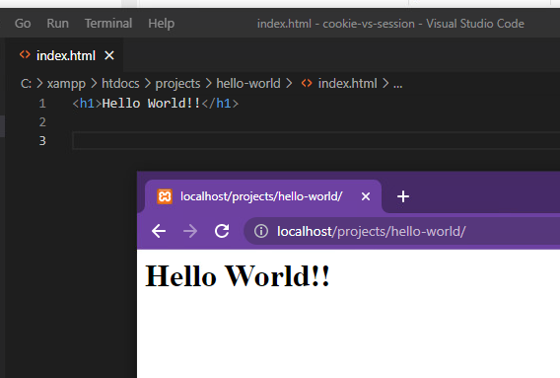
Create a hello world webpage
Create the above folder structure ( projects/hello-world )
Open VSCode
Add a new file called index.html

Slide 4
Today -- Back up code
This webpage is not backed up anywhere
The code is not managed
OneDrive?
Why not?
GitHub

Slide 5
GIThub
Create account
Windows git client
Ensure check in, check out, branch, merge, comment, etc

Slide 6
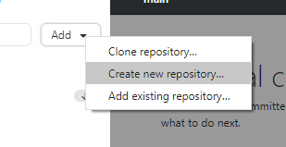
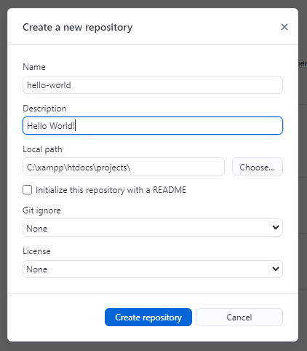

Slide 7
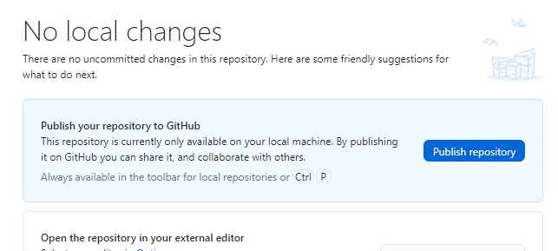
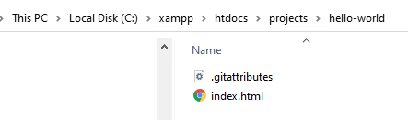

Slide 8
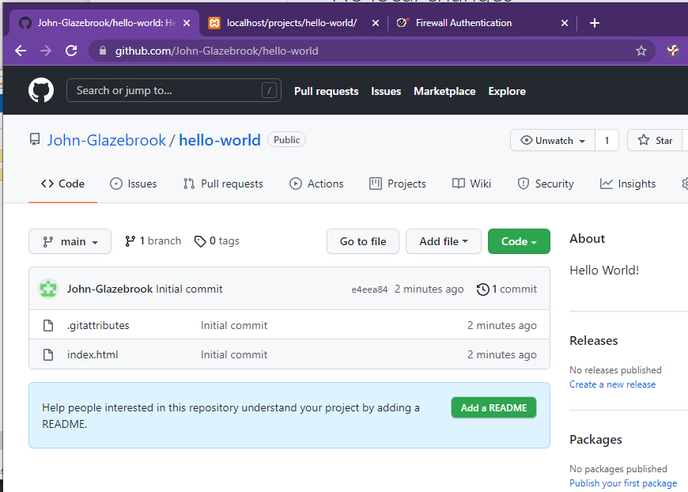

Slide 9
WARNING!!
It is your job to keep your files in github
To check in regularly
If you do not do this YOU WILL LOSE WORK
The VMs are NOT backed up
Your work is NOT backed up if you don’t commit to github

